Slide 1

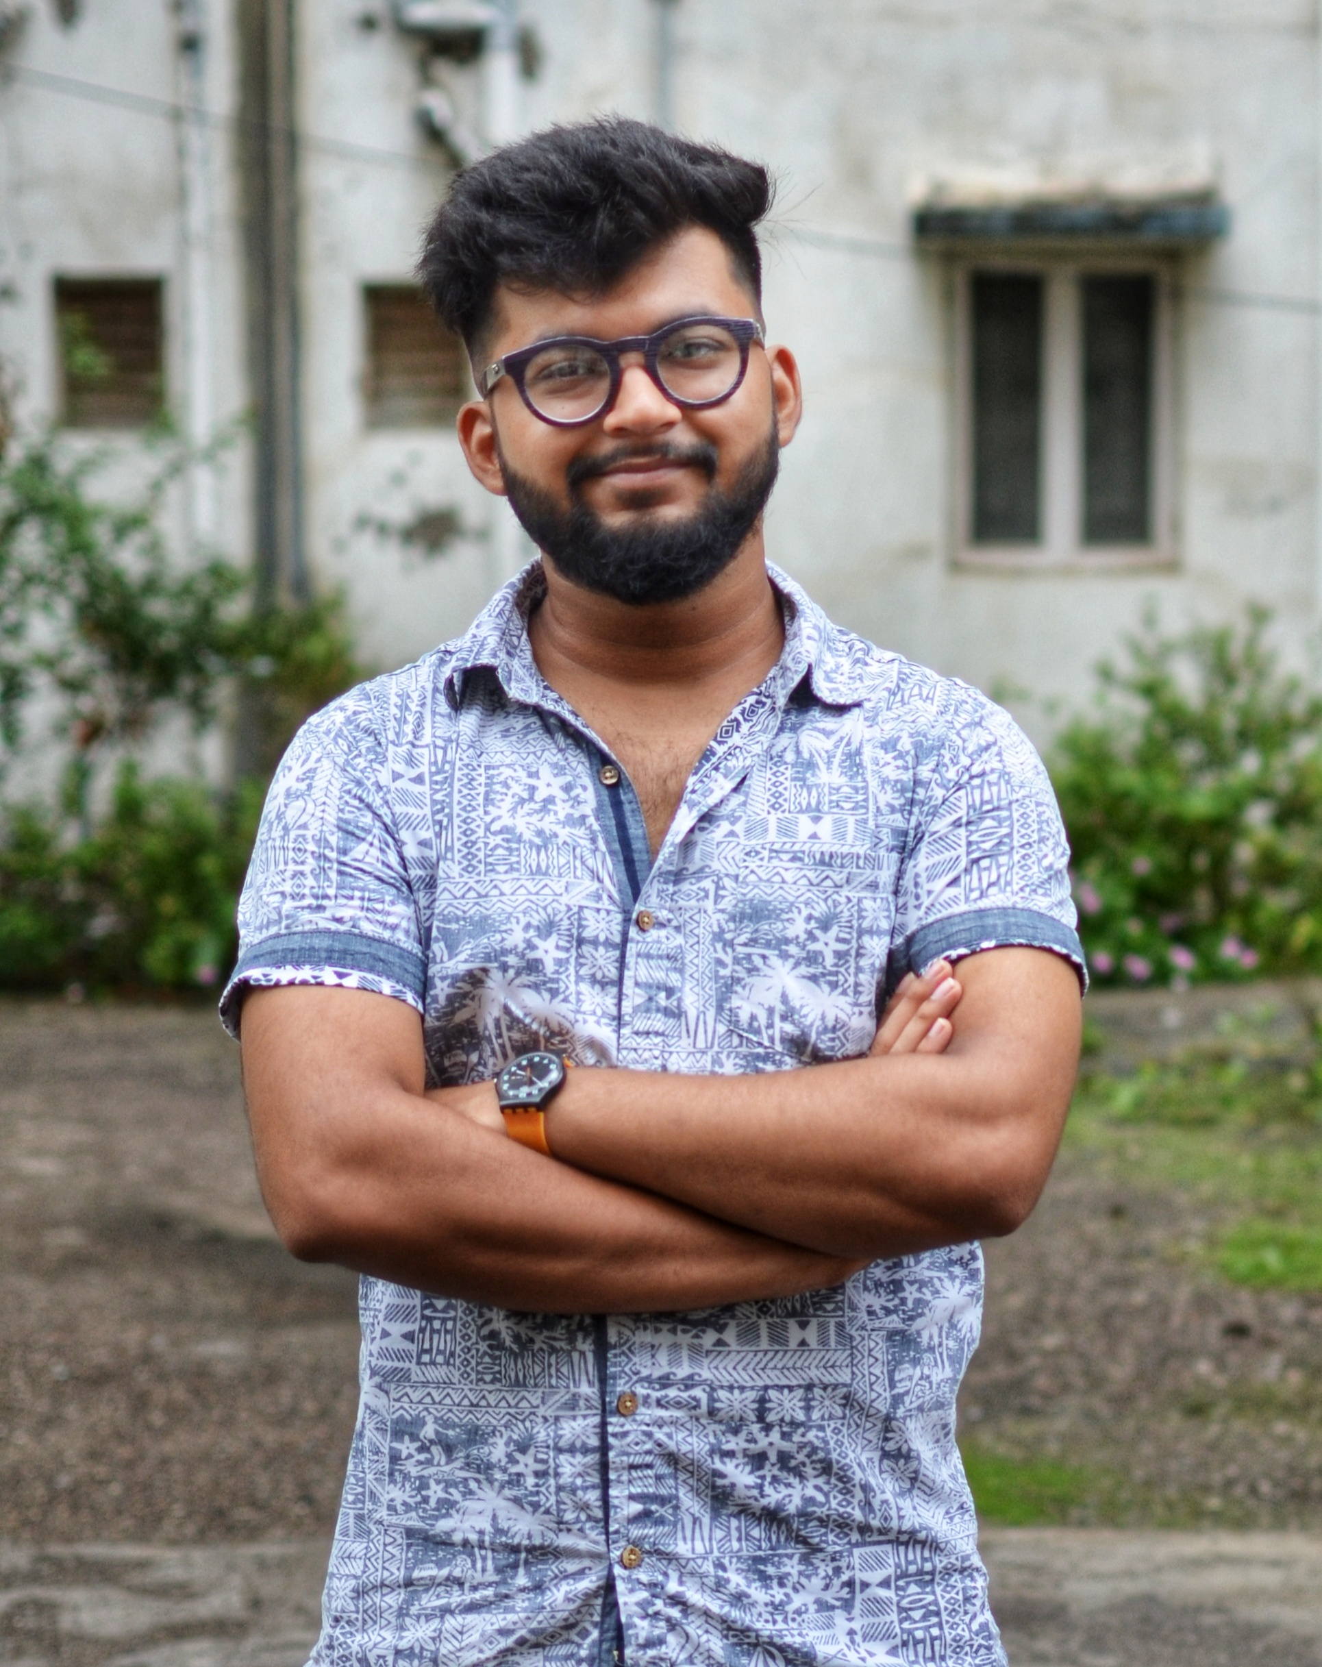
Chintan Davda
Email ID: davdachintan97@gmail.com
Contact Number: 8655191255
Linkedin: https://www.linkedin.com/in/chintan-davda-a29759144/
Github: https://github.com/chintan7786

Slide 2

TABLE OF CONTENT
1
2
3
4
5
UMD Interior LLP
Craftsworth Designs
Mail Blaster
Laxmi Industries
Apex Industries

Slide 3
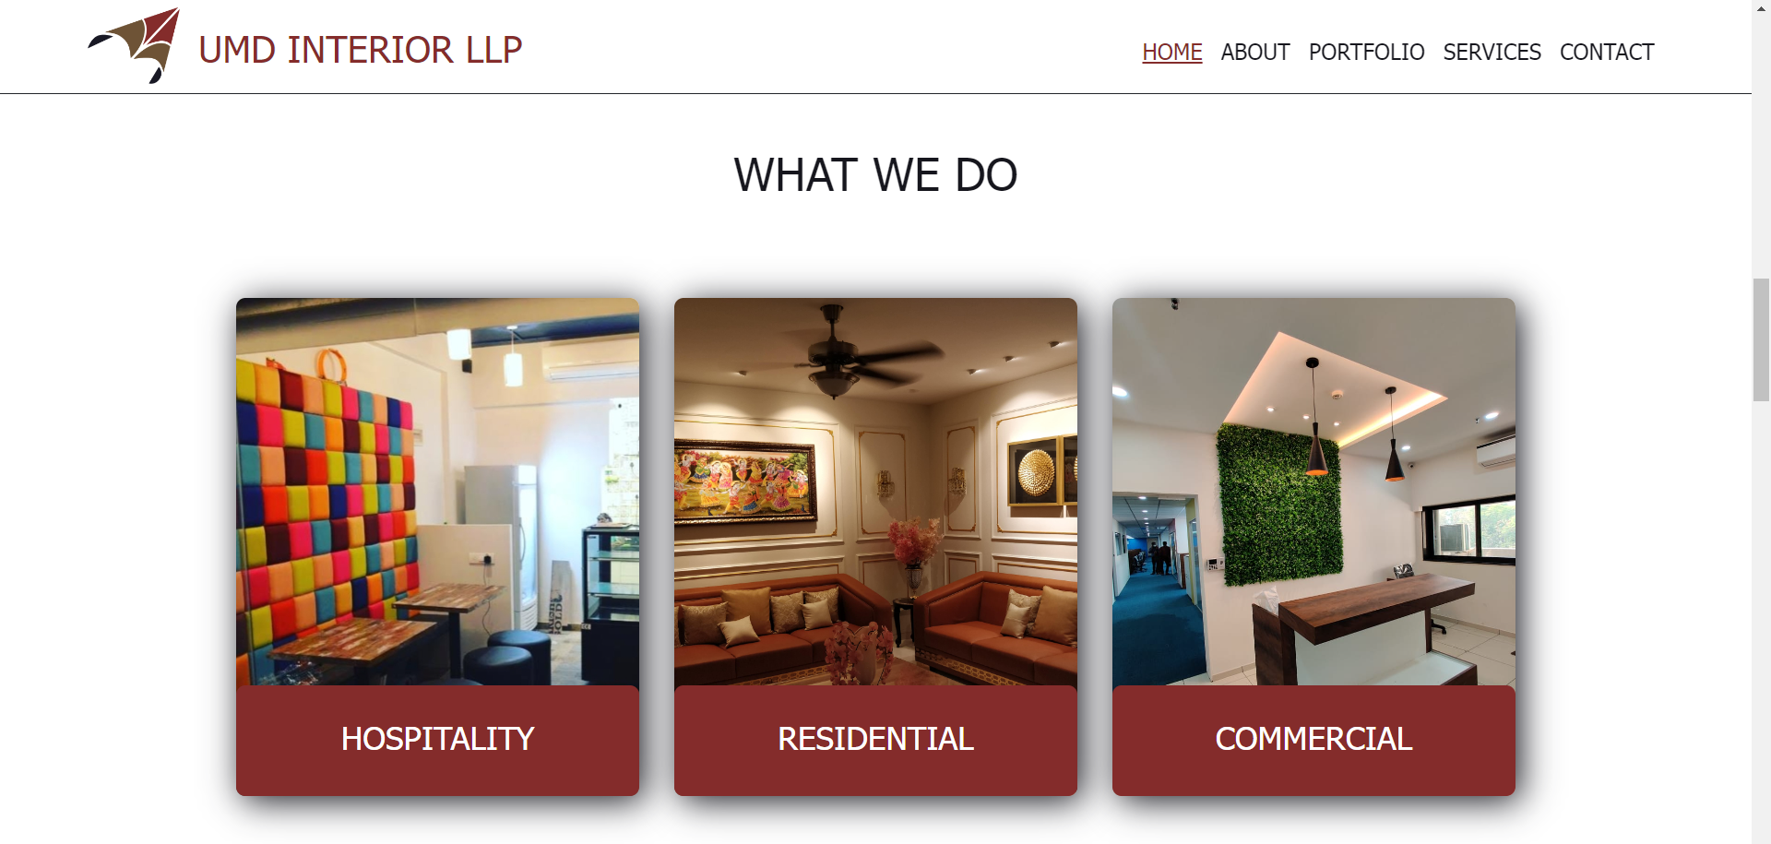
UMD Interior LLP

Slide 4
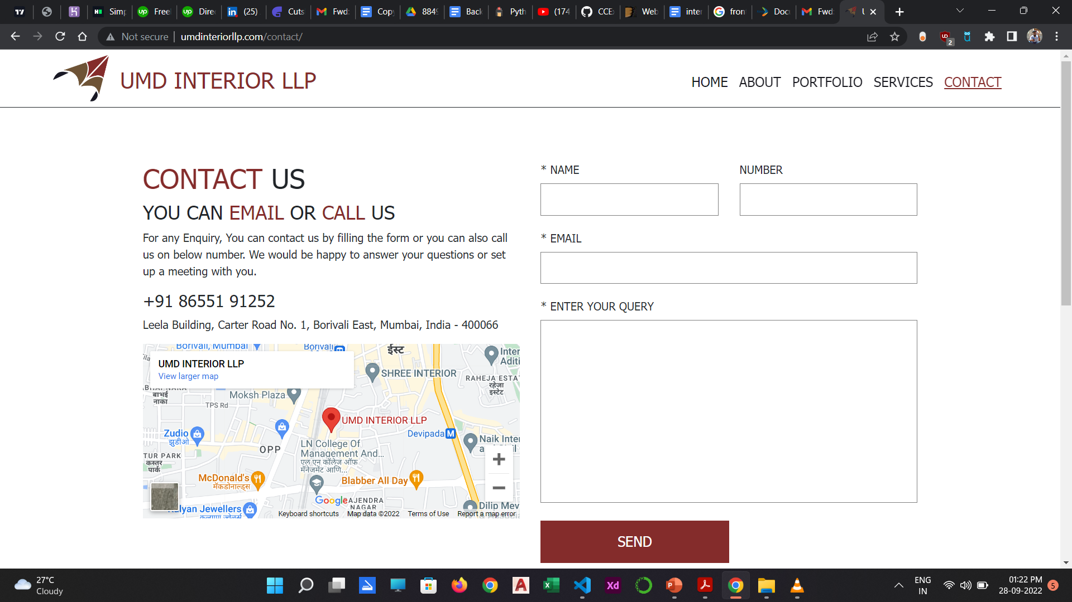
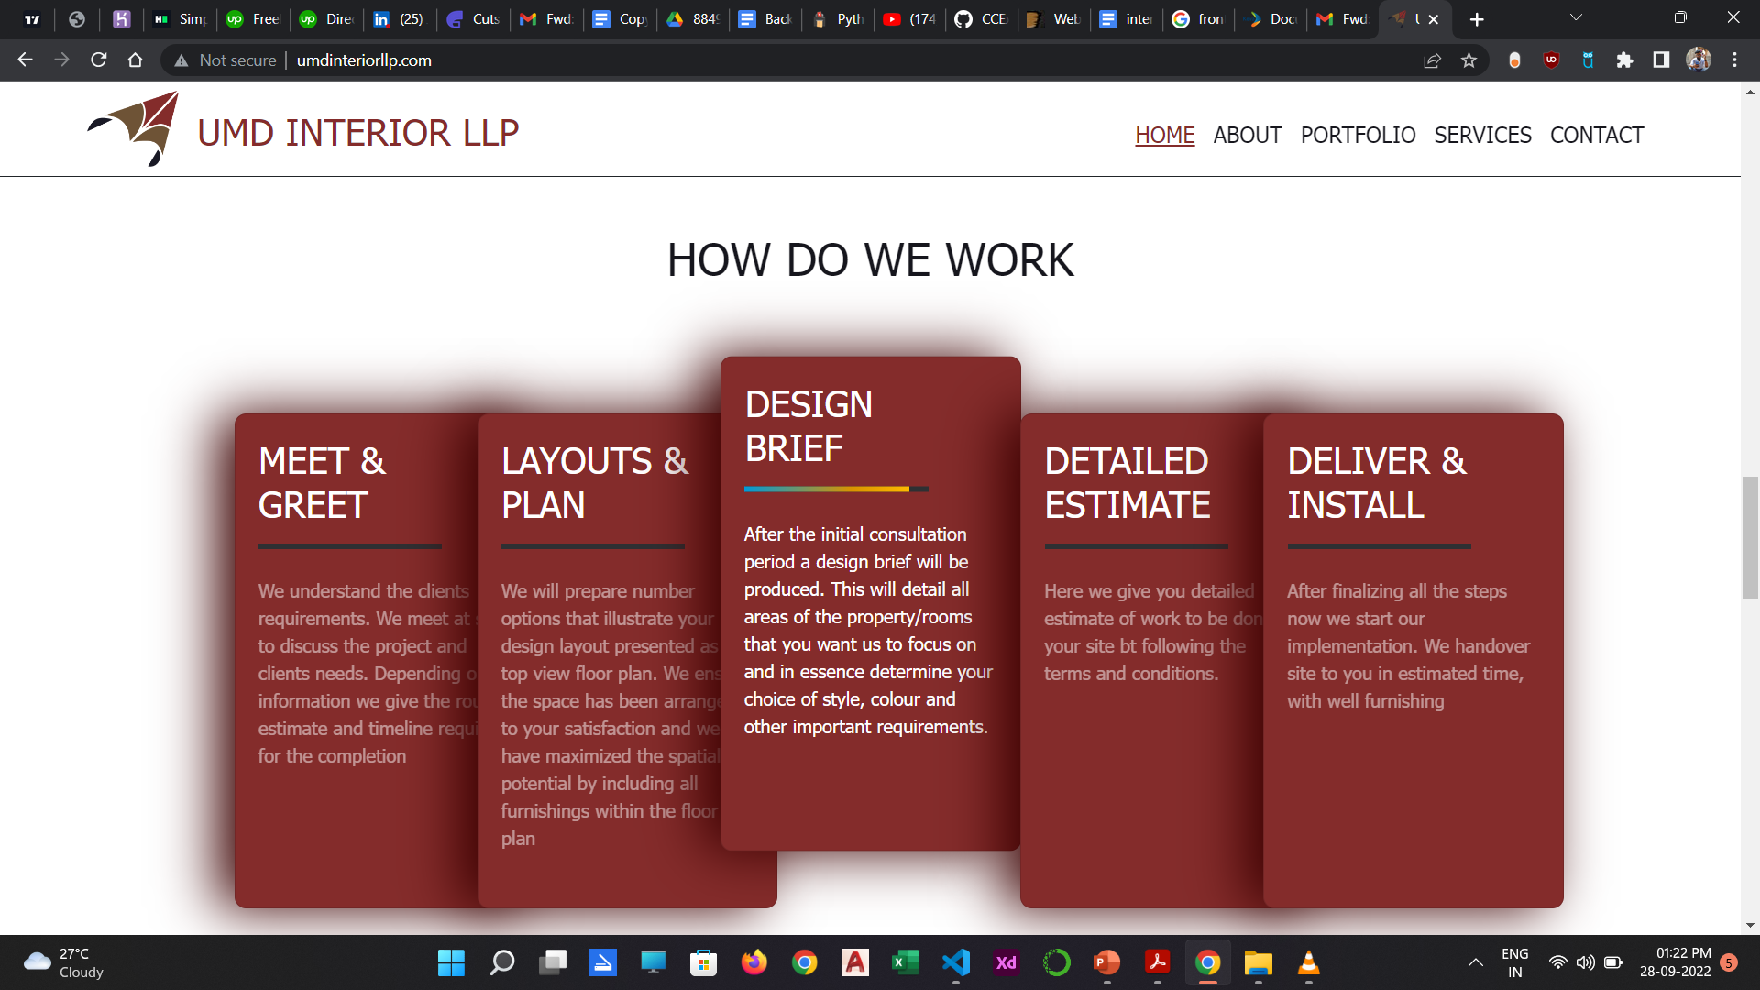

Slide 5


Craftsworth Designs

Slide 6
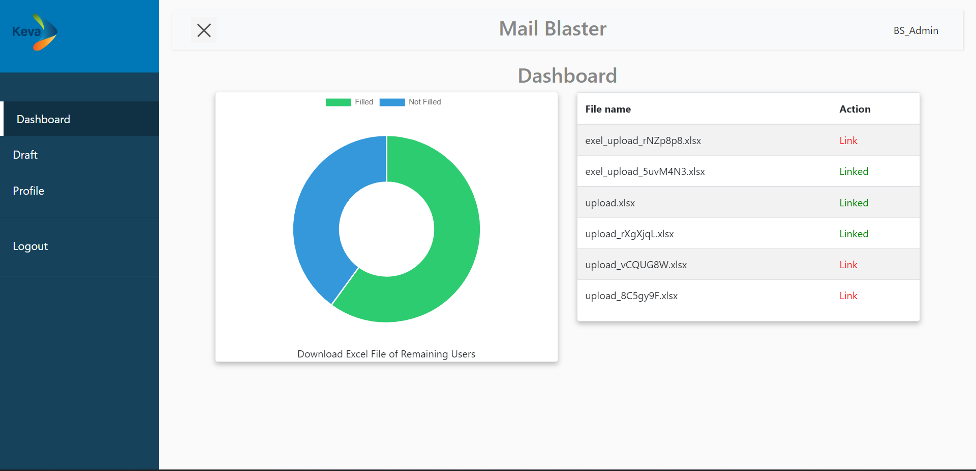
Mail Blaster

Slide 7
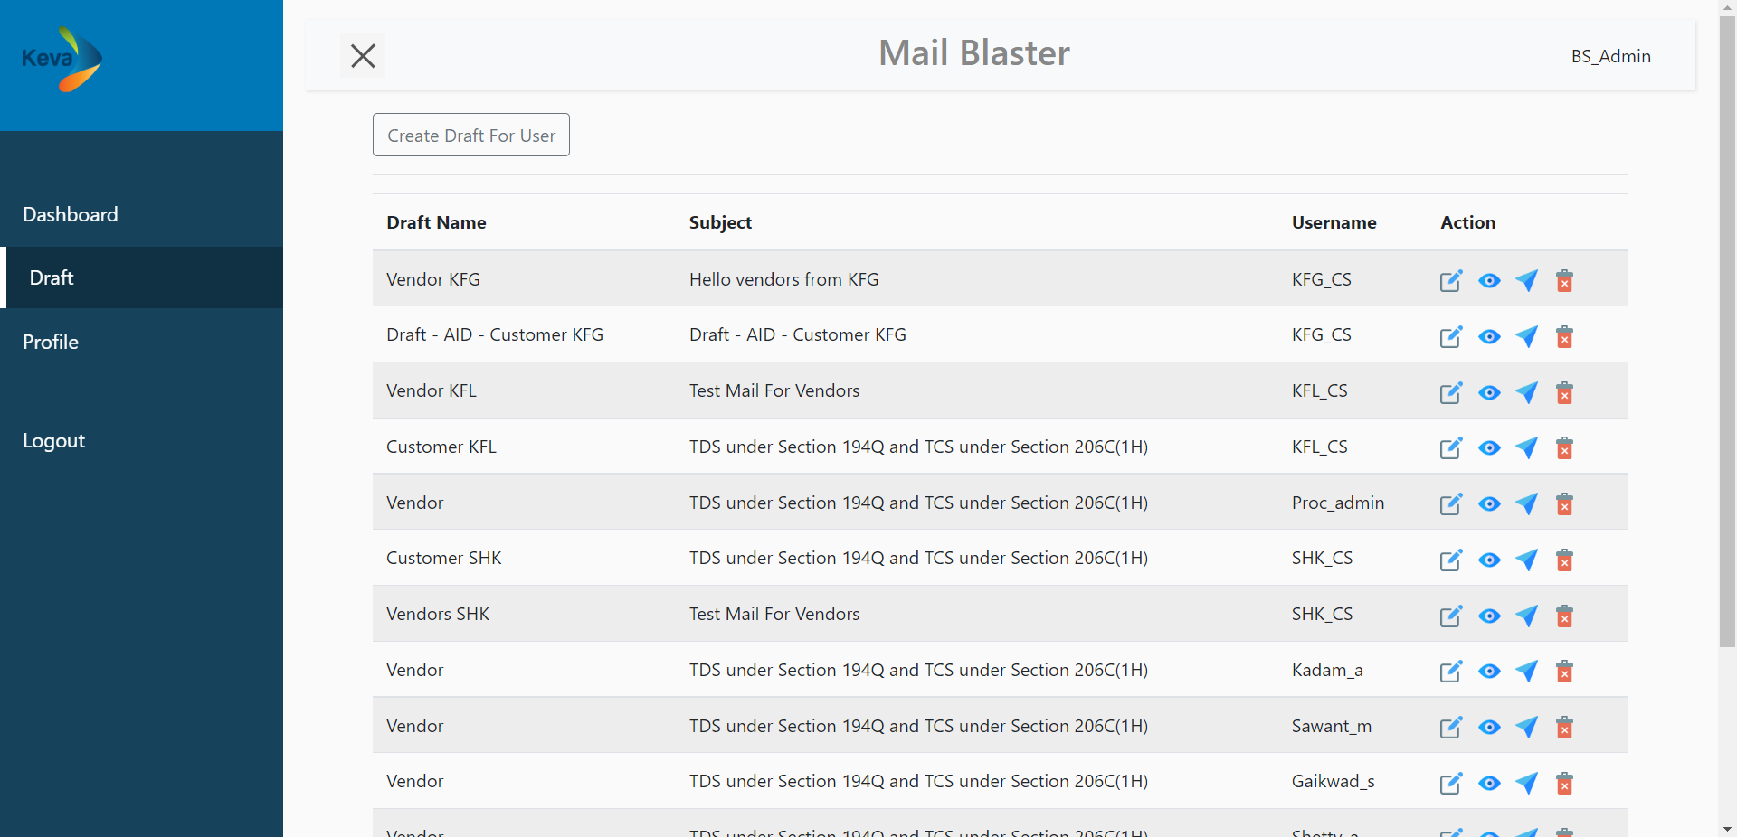

Slide 8
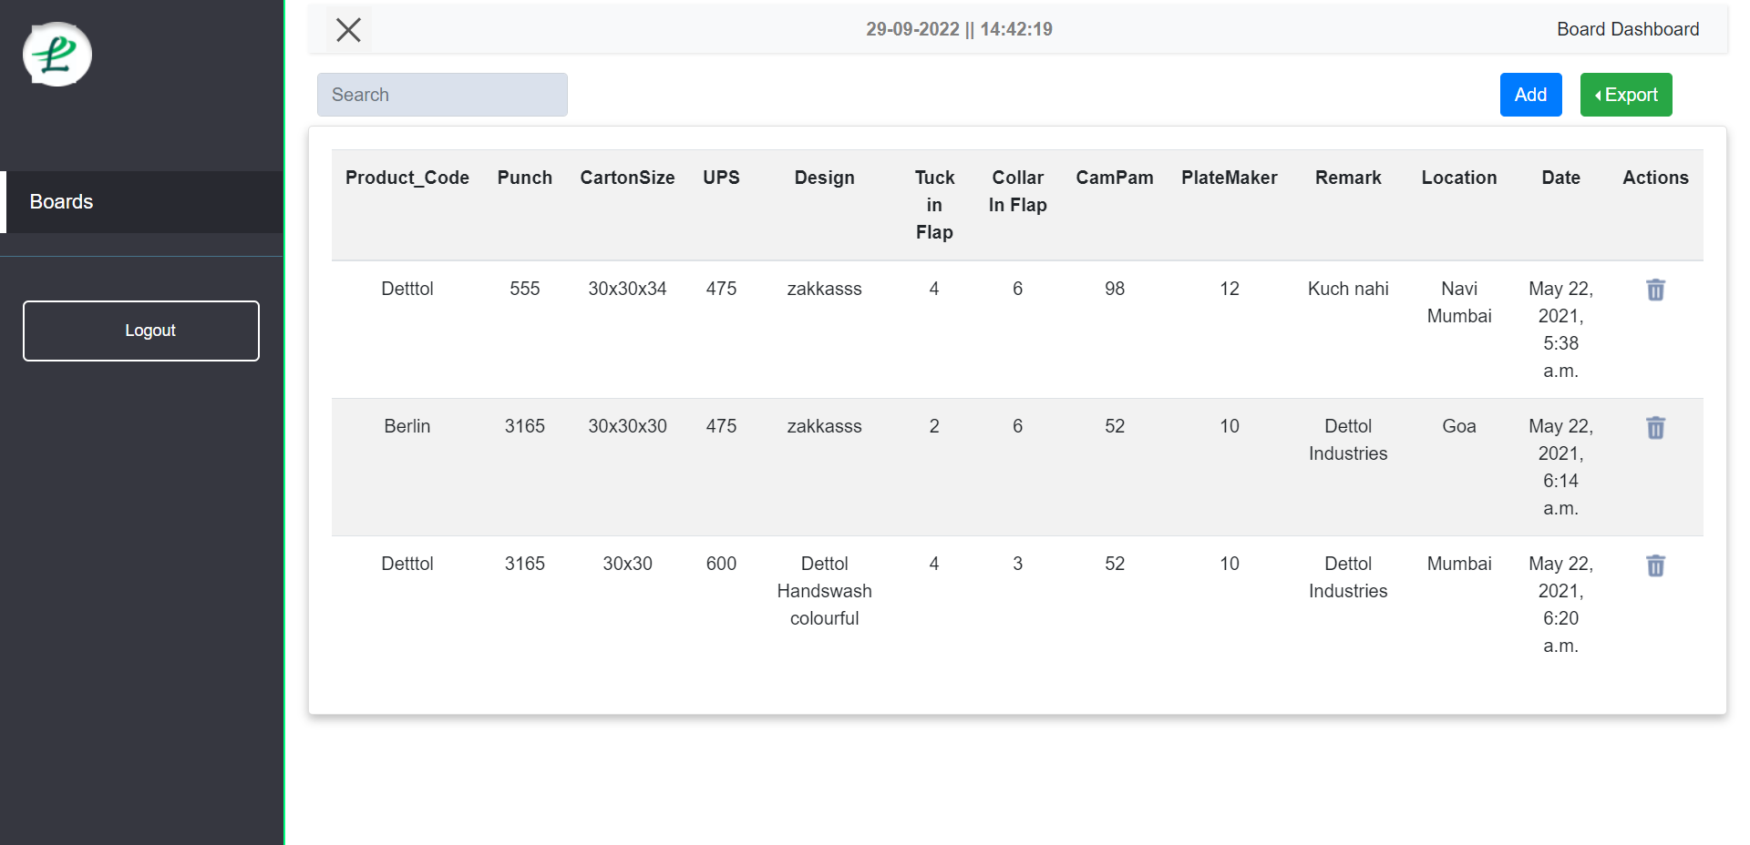
Laxmi Industries

Slide 9
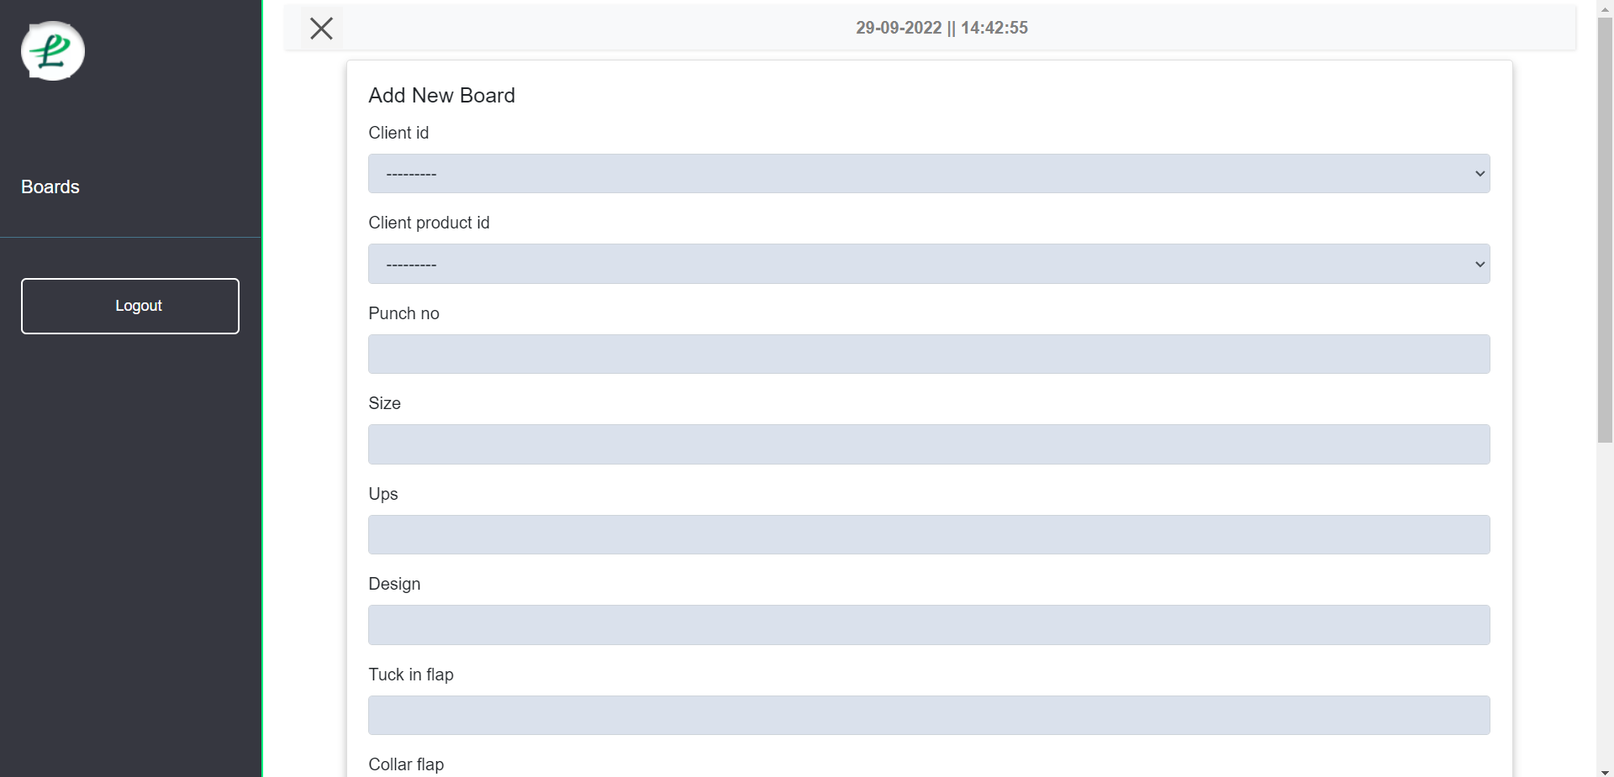

Slide 10
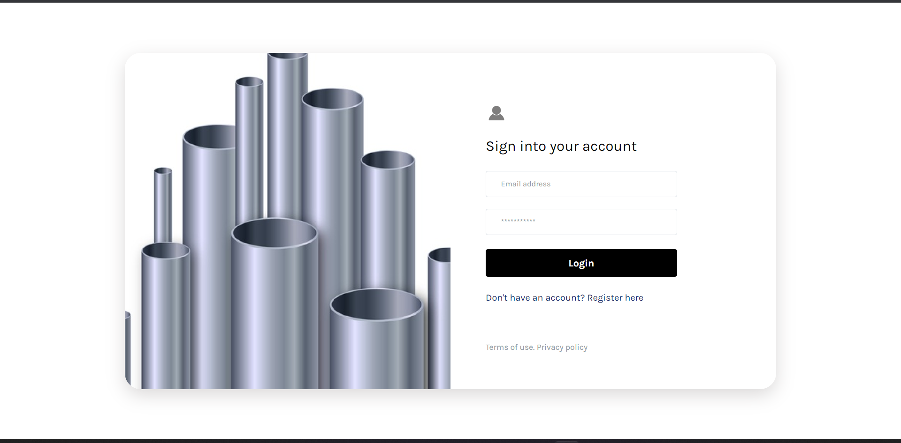
Apex Industries

Slide 11
